Slide 1
Common Stock Valuation – Chapter 8
Share of common stock is more difficult to value in practice than a bond for at least three reasons:
With common stock, not even the promised cash flows are known in advance.
Life of the investment is essentially forever because common stock has no maturity.
No way to easily observe the rate of return that the market requires.

Slide 2
Outline
Common Stock Valuation. (Dividend Discount Model)
Required rate of return and its components.
Stock Valuation using multiples
Some Features of Common and Preferred Stocks, and Shareholder Rights
The Stock Markets.

Slide 3


Notations
Per share value of Common stock today (Market Price)
Market price at the end of period 1
Market price at the end of period t
Current or last dividend paid per share
Per-share dividend expected at the end of period 1
Per-share dividend expected at the end of period t
Growth rate in dividends
Required return on common stock
$$D_{1}=$$
$$D_{t}=$$

Slide 4
Cash Flows
Imagine you are considering buying a share of stock today. You plan to sell the stock in one year. You somehow know that the stock will be worth $70 at that time. You predict the stock will also pay a $10 per share dividend at the end of the year. If you require a 25% return on your investment, what is the most you would pay for the stock? In other words, what is the present value of the $10 dividend along with the $70 ending value at 25%?
Present value
= current price of the stock
= the price of the stock in one period
= the cash divided paid at the end of the period
R = the required rate of return in the market on this investment

Slide 5
Substitute this expression for into our expression for
The price of the stock today is equal to the present value of all the future dividends.

Slide 6
Growth Stocks
You might be wondering about shares of stock in companies such as Alphabet that currently pay no dividends. Small, growing companies frequently plow back everything and pay no dividends. Are such shares worth nothing? It depends. When we say that the value of the stock is equal to the present value of the future dividends, we don’t rule out the possibility that some number of those dividends are zero. They just can’t all be zero.
Imagine a company that has a provision in its corporate charter that prohibits the paying of dividends now or ever. The corporation never borrows any money, never pays out any money to stockholders in any form whatsoever, and never sells any assets. Such a corporation couldn’t really exist because the IRS wouldn’t like it, and the stockholders could always vote to amend the charter if they wanted to. If it did exist, however, what would the stock be worth?
The stock would be worth absolutely nothing. Such a company would be a financial “black hole.” Money goes in, but nothing valuable ever comes out. Because nobody would ever get any return on this investment, the investment would have no value. This example is a little absurd, but it illustrates that when we speak of companies that don’t pay dividends, what we really mean is that they are not currently paying dividends.

Slide 7
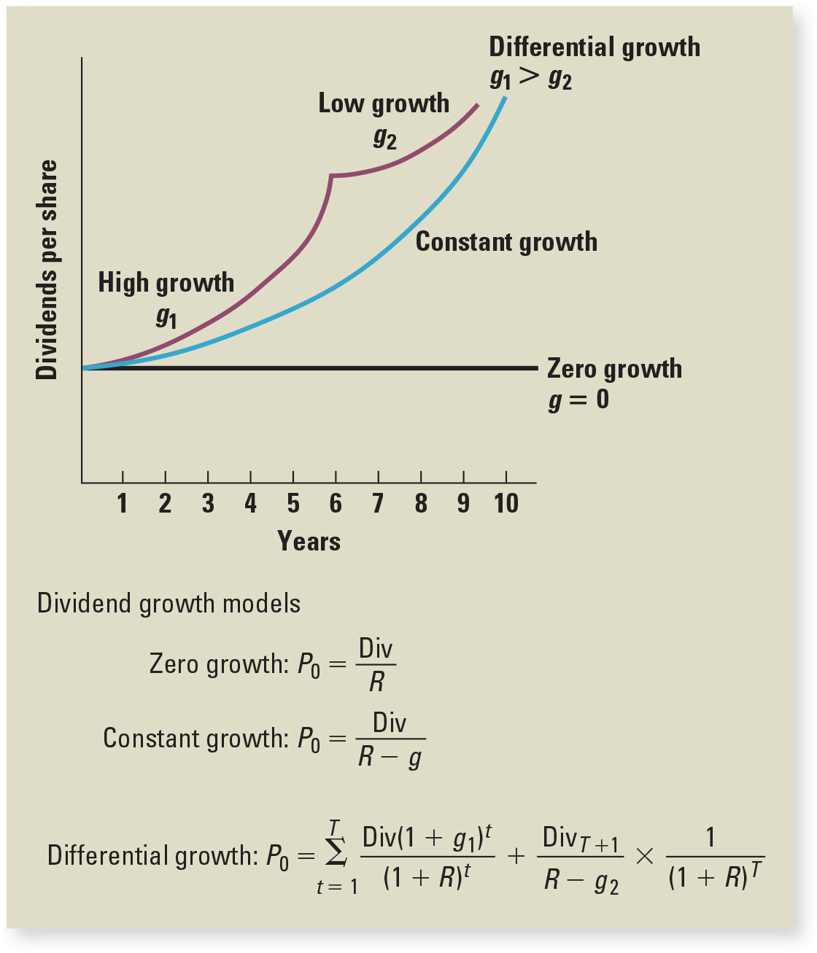
Patterns of dividends we will consider (three cases)
Zero Growth
Constant Growth
Nonconstant Growth
    Two-Stage Growth
    Special Cases
    Dividend as an Annuity
    Delayed dividend as an annuity
    Uneven dividends

Slide 8
1. Zero Growth
A share of common stock in a company with a constant (fixed) dividend is much like a share of preferred stock.
Dividend on a share of preferred stock has zero growth and is constant through time; for a zero-growth share of common stock, this implies that:
Value of the stock is:
Stock may be viewed as ordinary perpetuity with cash flow equal to D every period, with the per-share value given by:
R = the required return.

Slide 9
Example: Zero Growth – Preferred Stock Valuation
The zero Growth equation can be used to find the value of preferred stock (perpetuity).
For example, a preferred stock paying a $5 stated annual dividend and having a required return of 13% would have a value, per share of:

Slide 10
Example – Zero Growth Case
How much would you be willing to pay for a stock that is currently paying a divided of $3 and is expected to continue paying this same level of dividends if your opportunity cost is 8%?
What would the expected price be in 6 years?
Remember, dividend is constant

Slide 11
Practice: Zero Growth Case
Scotto Corp is a mature firm in its industry. The firm has been paying a common stock dividend of $2.40 per share for the past 15 years. The firm has stable sales and earnings, so it is expected to continue paying the same level of dividends in the foreseeable future.
a) If the required return is 12%, what will be the value of Scotto’s common stock today? (20)
b) If the required return is 14%, what will be the value of Scotto’s common stock today? (17.14)
c) If the required return is 14%, what will the expected value of Scotto’s common stock be at the end of 3 years? (17.14)

Slide 12
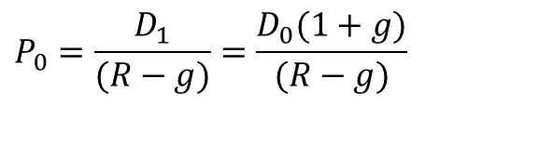
Case 2: Constant Growth (in dividends)
Assume that dividends will grow at a constant rate, g, forever, i.e.,
.
Since future cash flows grow at a constant rate forever, the value of a constant growth stock is the present value of a growing perpetuity:
.
.
$$P_{0}=\frac{D_{1}}{(R−g)}=\frac{D_{0}(1+g)}{(R−g)}$$

Slide 13
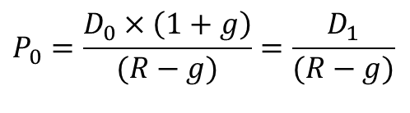
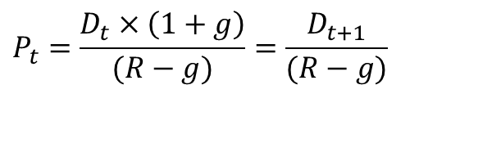
Constant Growth
The dividend growth model determines the current price of a stock as its dividend next period divided by the discount rate less the dividend growth rate, and can be written as follows, so long as the growth rate, g, is less than the discount rate, R: (Condition R<g)
$$P_{0}=\frac{D_{0}×\left(1+g\right)}{(R−g)}=\frac{D_{1}}{(R−g)}$$
Growing Perpetuity
We can use the dividend growth model to get the stock price at any point in time; in general, the price of the stock as of Time t is:
$$P_{t}=\frac{D_{t}×\left(1+g\right)}{(R−g)}=\frac{D_{t+1}}{(R−g)}$$

Slide 14

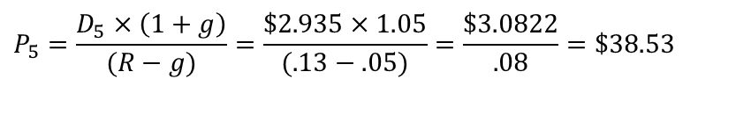
Example: Constant Growth
Suppose the company just paid divided of $2.30, dividend is growing at a constant rate of 5% and the required rate of return is 13%
= $2.30, g = 5%, R = 13%
Suppose we are interested in the price of the stock in five years,
We first need the dividend at Time 5,
Because the dividend just paid is $2.30 and the growth rate is 5% per year,
$D_{5}=D_{0}×\left(1+g\right)$⁵
$$D_{5}=\text{ \$}2.30×{\left(1+.05\right)}^{5}=2.30×1.2763=\$2.935$$
The price of the stock in five years is:
$$P_{5}=\frac{D_{5}×\left(1+g\right)}{(R−g)}=\frac{\$2.935×1.05}{(.13−.05)}=\frac{\$3.0822}{.08}=\$38.53$$

Slide 15
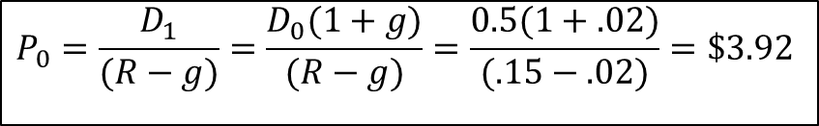
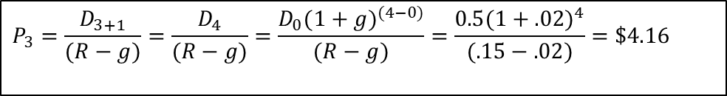
Example - Constant growth
Suppose Big D, Inc., just paid a dividend of $.50. It is expected to increase its dividend by 2% per
year. If the market requires a return of 15% on assets of this risk level.
how much should the stock be selling for?
What would the expected price be in 3 years?
Current Price is PV of growing perpetuity:
Expected price in 3 years:
We are finding a present value, so the dividend needed is the one that will be paid NEXT period, not the one that has already been paid.
When dividend is growing at a constant rate, the price would grow at that same rate.
$$P_{0}=\frac{D_{1}}{(R−g)}=\frac{D_{0}(1+g)}{(R−g)}=\frac{0.5(1+.02)}{(.15−.02)}=\$3.92$$
$$P_{3}=\frac{D_{3+1}}{(R−g)}=\frac{D_{4}}{(R−g)}=\frac{D_{0}(1+g)^{(4−0)}}{(R−g)}=\frac{0.5(1+.02)^{4}}{(.15−.02)}=\$4.16$$
Expected price in 3 years can also be calculated as: P3=P0 x (1+g)^3 = 3.92 x (1+.02)^3 = 4.16

Slide 16
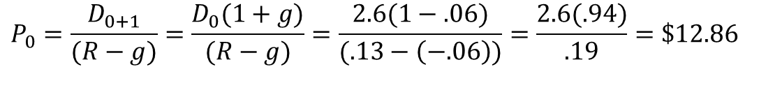
Example – Negative Constant Growth
A company in a dying industry just paid a dividend of $2.60. Its dividends is expected to decline continuously by 6% per year. What would you expect the current price per share to be, if the required rate of return is 13%
Firm still has earnings and still pays dividends, so P0 > 0:
$$P_{0}=\frac{D_{0+1}}{(R−g)}=\frac{D_{0}(1+g)}{(R−g)}=\frac{2.6(1−.06)}{(.13−\left(−.06\right))}=\frac{2.6(.94)}{.19}=\$12.86$$
What would you expect the price to be in 6 years?
$$P_{6}=\frac{D_{6+1}}{(R−g)}=\frac{D_{7}}{(R−g)}=\frac{D_{0}(1+g)^(7−0)}{(R−g)}=\frac{2.6\left(1−.06\right)^7}{(.13−\left(−.06\right))}=\frac{2.6(.6485)}{.19}=\$8.874$$

Slide 17
Practice: Constant Growth
1) You are evaluating common stock of The Solomon Company. The firm’s dividend next year is expected to be $2.45, and it is expected to be grow at a constant rate of 5%.
If you can earn 13% on similar-risk investments, what is the most you would be willing to pay for one share of Elk today? (30.63)
If you can earn only 11% on similar-risk investments, what is the most you would be willing to pay for one share of Elk today? (40.83)
If you can earn 11% on similar-risk investment, what would the expected price of Elk stock be in 5 years? (54.72)
P5 | D6/(r-g)
D6 | D6*(1+g)/(R-g)
D6 | D1*(1+g)^(6-1)
 | 3.126889828
P5 | =Z22*(1+0.05)/(0.11-0.05)
2) What would you be willing to pay for a sock that does not pay dividend at the current time, but is expected to start paying dividend of $2.50 in 6 years and to continue paying this same level of dividend indefinitely? Your required rate of return on this stock is 16%. (15.62)

Slide 18
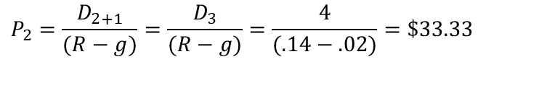
Example – Delayed constant growth dividends
A company is expected to pay $4 in dividend in 3 years, after which dividend is expected to grow at a constant rate of 2% indefinitely. How much would an investor be willing to pay for this stock if the required rate of return is 14%?
Solution:
Price in year 2 is PV of a growing perpetuity
Price in year 0 is PV of lump sum
$$P_{2}=\frac{D_{2+1}}{(R−g)}=\frac{D_{3}}{(R−g)}=\frac{4}{(.14−.02)}=\$33.33$$

Slide 19
Case 3: Non-Constant Growth (Differential Growth case)
Main reason to consider this case is to allow for “supernormal” growth rates over some finite length of time.
It require dividends start growing at a constant rate sometime in future.
Consider the case of a company that is currently not paying dividends. You predict that, in five years, the company will pay a dividend for the first time. The dividend will be $.50 per share. You expect that this dividend will then grow at a rate of 10% per year indefinitely. The required return on companies such as this one is 20%. What is the price of the stock today?
Find out what it will be worth once dividends are paid; price in four years will be:
If the stock will be worth $5 in four years, then we can get the current value by discounting this price back four years at 20%:

Slide 20
How to value Differential Growth Stock
To value a Differential Growth Stock, we need to:
  Estimate future dividends in the foreseeable future.
  Estimate the future stock price when the stock becomes a Constant Growth Stock (case 2).
  Compute the total present value of the estimated future dividends and future stock price at the appropriate discount rate.

Slide 21
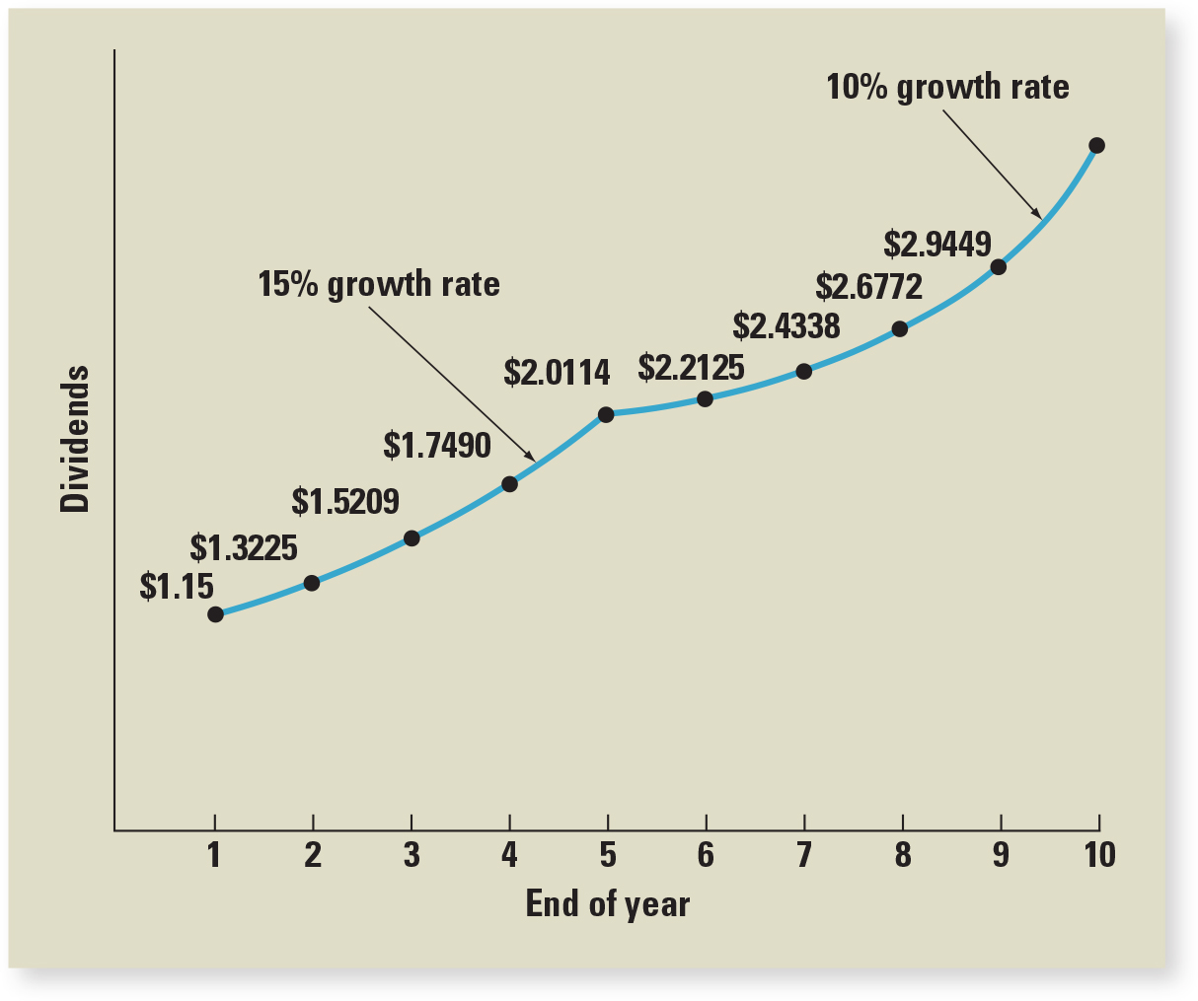
Example: Non-Constant Growth
A company is expected to pay $1.5 in dividend next year. Dividend is expected to grow at a rate of 15% for the next five years, after which it will grow at a long-term constant rate of 10%. Required rate of return in 13%.
Calculate the current price for this stock.
D1 = 1.15
G1 = 15%
G2 = 10%

Slide 22

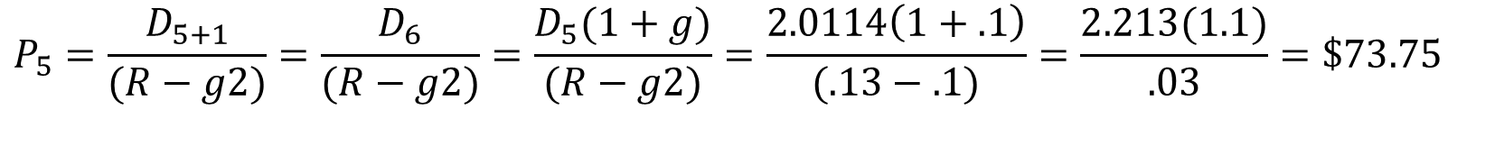

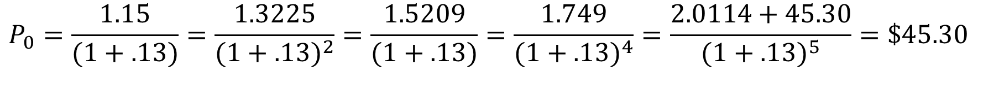





Step 1: find dividend 1-5
$D_{2}=D_{1}×\left(1+g1\right)$
= 1.15 x (1+.15)= 1.3225
$$D_{3}=D_{2}×\left(1+g1\right)$$
= 1.3225 x $\left(1+.15\right)$ = 1.5209
$$D_{4}=D_{3}×\left(1+g1\right)$$
= 1.5209 x $\left(1+.15\right)$ = 1.749
$$D_{5}=D_{0}×\left(1+g1\right)$$
= 1.749 x $\left(1+.15\right)$ = 2.0114
Step 2: Find price in year 5
$$P_{5}=\frac{D_{5+1}}{(R−g2)}=\frac{D_{6}}{(R−g2)}=\frac{D_{5}(1+g)}{(R−g2)}=\frac{2.0114\left(1+.1\right)}{(.13−.1)}=\frac{2.213(1.1)}{.03}=\$73.75$$
$$P_{0}=\frac{D_{1}}{(1+R)}=\frac{D_{2}}{(1+.R)^{2}}=\frac{D_{3}}{(1+R)^{3}}=\frac{D_{4}}{(1+R)^{4}}=\frac{D_{5+}P_{5}}{(1+R)^{5}}=\$45.30$$
Step 3 find Price in year 0
$$P_{0}=\frac{1.15}{(1+.13)}=\frac{1.3225}{(1+.13)^{2}}=\frac{1.5209}{(1+.13)}=\frac{1.749}{(1+.13)^{4}}=\frac{2.0114+45.30}{(1+.13)^{5}}=\$45.30$$

Slide 23
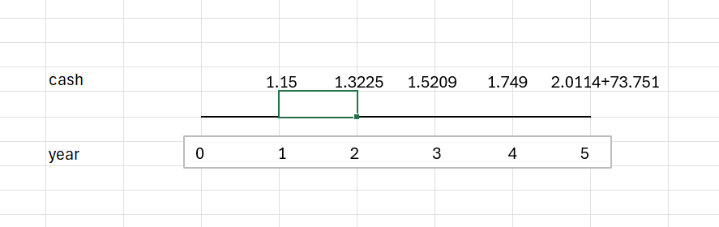
Timeline
1.15 1.3225 1.5209 1.749 2.0114
0 1 2 3 4 5

Slide 24
Using financial calculator to find price in year 0 – Using cash flow function
Use the cash flow menu: use enter and down arrow.
To clear cash flow registry press CF---→ 2nd---→ CER Work
F5
1
CF0
0
CF3
1.5209
NPV
CF1
1.15
F3
1
I
13
F1
1
CF4
1.7490
NPV
CF2
1.3225
F4
1
CPT
45.20
F2
1
CF5
2.0114+73.571
https://www.youtube.com/watch?v=yW1BTmxQeDc
Notes:
24

Slide 25
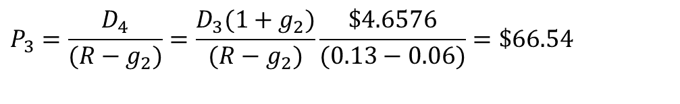
Example 2: None constant growth
A common stock just paid a dividend of $2. The dividend is expected to grow at 30% for 3 years, then it is expected to have a long-run constant growth rate of 6%.
What is the stock worth if the required rate of return on similar risk investments is 13%.
Step 1
Step 2
$$P_{3}=\frac{D_{4}}{(R−g_{2})}=\frac{D_{3}(1+g_{2})}{(R−g_{2})}\frac{\$4.6576}{(0.13−0.06)}=\$66.54$$
Notes:
25
17

Slide 26
Step 3

Slide 27
Solution - continued
In dealing with nonconstant growth, a timeline can be helpful.
r =13%
Step 1
0
1
2
3
4
g = 30%
g = 30%
g = 30%
g = 6%
D₀ = 2.00 2.60 3.38 4.394 4.6576
2.30
2.65
3.05
46.11
$54.11 = P₀
Step 3
Step 2
Notes:
27
18

Slide 28
Using financial calculator to find price in year 0 – Using cash flow function
Use the cash flow menu: use enter and down arrow.
To clear cash flow registry press CF---→ 2nd---→ CER Work
CF0
0
CF3
4.394+66.54
CPT
54.11
CF1
2.60
F3
1
F1
1
NPV
CF2
3.38
I
13
F2
1
NPV
https://www.youtube.com/watch?v=yW1BTmxQeDc
Notes:
28

Slide 29
Example 3 – Nonconstant growth
A company is expected to have the following growth pattern in its dividends:
No growth for the first three years
A constant growth rate of 6% thereafter.
The company just paid its annual dividend of $2.00 (this is D0)
Required rate of return is 13%.
What is the expected current market price?

Slide 30
Solution
r =13%
Step 1
0
1
2
3
4
...
g = 0%
g = 0%
g = 0%
g = 6%
2.00 2.00 2.00 2.00 2.12
1.7699
1.5663
1.3861
20.9895
25.7118
Step 3
Step 2
Notes:
30
21

Slide 31
Discounting all future cash flows for the timeline on previous slide

Slide 32
Using financial calculator to find price in year 0 – Using cash flow function
Use the cash flow menu: use enter and down arrow.
To clear cash flow registry press CF---→ 2nd---→ CER Work
CF0
0
CF3
2+30.28.57
CPT
25.71
CF1
2
F3
1
F1
1
NPV
CF2
2
I
13
F2
1
NPV
https://www.youtube.com/watch?v=yW1BTmxQeDc
Notes:
32

Slide 33
Practice: Variable growth
To buy back its own shares, Pennzoil Co. has decided to suspend its dividends for the next two years. It will resume its annual cash dividend of $2.00 in year 3 and year 4. Thereafter, the dividend will grow at an annual growth rate of 6% forever. The required rate of return on Pennzoil’s stock is 16%. According to the discounted dividend model, what should Pennzoil’s currant share price be? (13.49)
Corn Inc. has just paid its annual dividends of $3. Dividends expected to grow at a rate of 16% for the next two years after which dividend is expected to grow at a constant rate of 8% for ever.
What is the current value of one share of Corn Inc stocks today, if the required rate of return is 13%? (68.41)
D1 | 0
D2 | 0
D3 | 2
D4 | 2
P4 | 21.2
D0 | 3
D1 | 3.48
D3 | 4.04
D4 | 98.21

Slide 34
Special cases
Dividend as an Annuity
Delayed dividend as an annuity
Uneven dividends

Slide 35
Example: Annuity
A company is expected to pay $2.00 in divided for the next 11 years then discontinue paying dividend. Required rate of return is 13%
a) What is the market value per share today?
b) What would you expect the market value to be in 5 years?
c) What would you expect the market value to be in 11 years? (0)

Slide 36
a.
11 13 -2 0
INPUTS
N
I/Y
PV
PMT
FV
OUTPUT
11.37
b.
6 13 -2 0
INPUTS
N
I/Y
PV
PMT
FV
OUTPUT
8.00
Notes:
36
21

Slide 37
Example: Delayed Annuity
A company is not expected to pay any dividends for the next 5 years. Its first dividend of $2.00 will be paid in 5 years and it will continue paying same level of divided for 11 years after which it will discontinue paying dividend. Required rate of return is 13%
a) What is the market value per share today
b) What would you expect the market value to be in 5 years?
c) What would you expect the market value to be in 11 years?

Slide 38
Example – Delayed Dividends (delayed annuity)
What would you be willing to pay for a sock that does not pay dividend at the current time, but is expected to start paying dividend of $2.50 in 6 years and to continue paying this same level of dividend indefinitely? Your required rate of return on this stock is 16%.
Solution: This is an example of a delayed perpetuity.
Step 1: Price in year 5 is PV of a perpetuity
Step 2: Price in year 0 is PV of a lump sum

Slide 39
Step 2 using financial calculator
5 16 -15.625
INPUTS
N
I/Y
PV
PMT
FV
OUTPUT
7.43

Slide 40
Example: Uneven dividends
A company is expected to pay the following divided over the next 6 years then discontinue paying divided after that. Required rate of return is 16%
a) What is the most you would pay for one stock for this company?
b) How much would you be willing to pay, in 7 years for one stock of this company? (0)
year | dividends
1 | 1.50
2 | 1.25
3 | 1.00
4 | 0.75
5 | 0.50
6 | 0.25

Slide 41
Using financial calculator to find price in year 0 – Using cash flow function
Use the cash flow menu: use enter and down arrow.
F5
1
CF6
0.25
CF0
0
CF3
1.00
F3
CF1
1.5
F3
1
1
NPV
F1
1
CF4
0.75
I
16
CF2
1.25
F4
1
NPV
F2
1
CF5
0.50
CPT
3.62
Notes:
41

Slide 42
Practice: Special Cases
How much would you pay for the stock with constant dividend of $3 and 8% required rate of return if the constant dividend is expected to pay its last dividend in 10 years? (20.13)
What would you expect the price to be in 10 years? (0)
2) A company is not expected to pay any dividends for the next 5 years. Its first dividend of $2.00 will be paid in 6 years and it will continue paying same level of divided for 11 years after which it will discontinue paying dividend. Required rate of return is 13% (last dividend in year 16)
a) What is the market value per share today? (6.17)
c) What would you expect the market value to be in 16 years? (0)

Slide 43
The Required Return and its Components
Start with the Dividend Discount Model:
Rearrange and solve for R:
Dividend yield
Capital gain yield
In a company with constant growth divided, the stock
price grows at the same rate as divided growth rate.

Slide 44
Total return, R, has two components:
Dividend yield is a stock’s expected cash dividend divided by its current price
Dividend growth rate, g, can be interpreted as the capital gains yield, the rate at which the value of an investment grows

Slide 45

Examples : Stock Returns
Suppose we observe a stock selling for $20 per share. The next dividend will be $1 per share. You think that the dividend will grow by 10% per year, indefinitely. What return does this stock offer if this is correct?
R = Dividend yield + Capital gains yield.
Total Return
Dividend Yield = 2/20 = .05 = 5%
D.Y. $=\frac{D_{1}}{P_{0}}$
Capital gain yield = dividend growth rate = 10%
Notice that Dividend Yield + Capital gain yield = Total Return

Slide 46
Example – Finding R (Rate of Return)
A company with a constant growth rate in earnings and dividends of 4% has just paid its annual dividend of $4.50. Its common stock is currently selling at $58.50
a) Calculate the rate of return on the stock given its
current market price.
b) What is the dividend yield?
c) What is the growth rate in dividends?
d) What is the expected market price in 12 years?

Slide 47
Solution
a) Rate of return (R)
b) Dividend yield = 8%
Dividend growth rate = 4%
Expected market price in 12 years
Method 1:
Method 2 – using capital gain yield

Slide 48
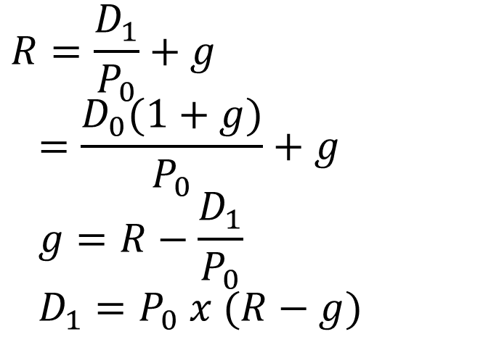
Finding D and g
You can also rearrange the basic DDM equation to calculate D and g
$$R=\frac{D_{1}}{P_{0}}+g=\frac{D_{0}(1+g)}{P_{0}}+g \\ g=R−\frac{D_{1}}{P_{0}} \\ D_{1}=P_{0} x (R−g)$$

Slide 49
Practice: Finding the rate of return, Dividend growth rate & Dividend
1) Corn Inc. is expected to pay $4 in dividend next year. Current price per share for its common stock is $40 and earnings & dividends are both growing at a constant rate of 3%
  What the rate of return on the stock? (13%
  What is the dividend yield? (10%)
  What is the capital gain yield? (3%)
  What is the expected price at the end of year 8? (50.67)
Dora company’s common stock currently sells for $40 per share. The required rate of return of on Dora’s stock is 16%, and their expected dividend next year is $2 per share. If Dora’s dividend is expected to continue growing at the same constant rate forever
  a. What is their expected capital gain yield (dividend growth rate)? (11%)
b. What is the dividend yield? (5%)

Slide 50
Price Earning (PE) Multiples approach
PE (Price to Earning) ratio represents the amount investors are willing to pay for each dollar of earning in share price.
P E ratio, calculated as the ratio of a stock’s price per share to its earnings per share (E P S) over the previous year.
Earning per share (EPS) is calculated by dividing NI by number of shares outstanding.
When PE multiple approach is used to estimate the firm’s share value, the firm’s expected EPS is multiplied by the estimated firm’s future PE ratio.
Often average PE ratio for the industry is used
This approach is also useful in valuing firms that are not publicly traded.

Slide 51
P E, P S, and E V/EBITDA Ratios for Various Industries
 | P E | P S | E V/EBITDA
Apparel | 10.50 | .81 | 8.17
Beverage (Soft) | 40.90 | 4.16 | 21.50
Cable TV | 11.08 | 1.19 | 7.76
Drugs (Biotechnology) | 34.86 | 5.78 | 27.4
Entertainment | 44.39 | 2.47 | 21.12
Farming/Agriculture | 33.56 | .94 | 14.70
Food wholesalers | 14.71 | .29 | 14.15
Furniture/Home furnishings | 11.39 | .60 | 6.77
Green & renewable energy | 40.26 | 3.68 | 14.64
Power | 18.11 | 2.14 | 13.48
Restaurant/Dining | 26.32 | 3.16 | 20.52
PE= Price Earning Ratio
PS = Price to Sale
EV = Enterprise Value
EBITDA = Earnings Before Interest, Taxes, Depreciation & Amortization

Slide 52
Summary of Stock Valuation 1
The General Case:
In general, the price today of a share of stock,
is the present value of all
of its future dividends,
where R is the required return.
Constant Growth Case:
If the dividend grows at a steady rate, g, then the price can be written as:
This result is called the dividend growth model.

Slide 53
Summary of Stock Valuation
Nonconstant Growth:
If the dividend grows steadily after t periods, then the price can be written as:
Two-Stage Growth:
If the dividend grows at rate
for t periods and then grows at rate
thereafter, then the price can be written as:

Slide 54
Summary of Stock Valuation
Valuation Using Multiples:
For stocks that don’t pay dividends (or have erratic dividend growth rates), we can value them using the PE ratio and/or the price-sales ratio:
The Required Return:
The required return, R, can be written as the sum of two things:
where
is the dividend yield and g is the capital gains yield (which is
thing as the growth rate in dividends for the steady growth case).
Notes:
For future reference, our discussion of stock valuation techniques is summarized in Table 8.2.

Slide 55
Common Stock Features: Shareholder Rights
Common stock is equity without priority for dividends or in bankruptcy.
Shareholders elect directors who, in turn, hire managers to carry out their directives.
Directors are elected each year at an annual meeting by a vote of the holders of a majority of shares who are present and entitled to vote.
In cumulative voting, a shareholder may cast all votes for one member of the board of directors; all directors are elected at once.
In straight voting, a shareholder may cast all votes for each member of the board of directors; directors are elected one at a time.
Many companies have staggered elections for directors (That is, classified boards), but several have been pressured to declassify.
Staggering has two basic effects:
Makes it more difficult for a minority to elect a director.
Makes takeover attempts less likely to be successful.

Slide 56
Common Stock Features: Proxy Voting and Stock Classes
A proxy is a grant of authority by a shareholder allowing another individual to vote his or her shares.
Shareholders can come to the annual meeting and vote in person, or they can transfer their right to vote to another party.
Most voting in large public corporations is done by proxy.
If shareholders are not satisfied with management, an “outside” group of shareholders can try to obtain votes via proxy, with the resulting battle called a proxy fight.
Some firms have more than one class of common stock:
For Example, Ford Motor Company has Class B common stock, which is not publicly traded.
Primary reason for creating dual or multiple classes of stock has to do with control of the firm.
If multiple classes exist, management can raise equity capital by issuing nonvoting or limited-voting stock while maintaining control.

Slide 57
Common Stock Features: Other Rights
In addition to the right to vote for directors, shareholders usually have the following rights:
Right to share proportionally in dividends paid.
Right to share proportionally in assets remaining after liabilities have been paid in a liquidation.
Right to vote on stockholder matters of great importance (For Example, a merger), with voting usually done at the annual meeting or a special meeting.
Stockholders sometimes have a pre-emptive right, the right to share proportionally in any new stock sold:
Purpose is to give stockholders the opportunity to protect their proportionate ownership in the corporation.
Company that wishes to sell stock must first offer it to the existing stockholders before offering it to the general public .

Slide 58
Common Stock Features: Dividends
Distinctive feature of corporations is that they have shares of stock on which they are authorized by law to pay dividends to their shareholders .
Dividends are payments by a corporation to shareholders, made in either cash or stock.
Payment of dividends is at discretion of the board of directors.
Important characteristics of dividends include the following:
Unless a dividend is declared by the board of directors of a corporation, it is not a liability of the corporation. A corporation cannot default on an undeclared dividend. Therefore, corporations cannot become bankrupt because of nonpayment of dividends.
Payment of dividends by the corporation is not a business expense. Dividends are not deductible for corporate tax purposes.
Dividends received by individual shareholders are taxable. In 2020, the tax rate was 15 to 20 percent.

Slide 59
Preferred Stock Features: Stated Value and Dividends
Preferred stock has dividend priority over common stock, normally with a fixed dividend rate, sometimes without voting rights.
Preferred shares have a stated liquidating value, usually $100 per share, with the cash dividend described in terms of dollars per share.
“$5 preferred” translates into a dividend yield of 5% of stated value.
Preferred dividend is not like interest on a bond.
Board of directors may decide not to pay dividends on preferred share, (which may have nothing to do with the current net income of the corporation), in which case:
  Common shareholders must also forgo dividends.
  Holders of preferred shares are often granted voting and other rights if preferred dividends have not been paid for some time.
Dividends payable on preferred stock are either cumulative or noncumulative, though most are cumulative.
Unpaid preferred dividends are not debts of the firm.

Slide 60
Preferred Stock Features: Is Preferred Stock Really Debt?
Good case can be made that preferred stock is really debt in disguise, a kind of equity bond, for the following reasons:
Preferred shareholders receive a stated dividend only.
If corporation is liquidated, preferred shareholders get a stated value .
Preferred stocks often carry credit ratings much like those of bonds.
Preferred stock is sometimes convertible into common stock.
Preferred stocks are often callable .
Many issues of preferred stock have obligatory sinking funds, effectively creating a final maturity.
In the 1990s, firms began to sell securities that looked a lot like preferred stocks but were treated as debt for tax purposes, making the interest payments tax deductible.
Until 2003, interest payments and dividends were taxed at the same marginal tax rate; when the tax rate on dividend payments was reduced, these instruments were not included.

Slide 61
The Stock Markets: Dealers and Brokers
The stock market consists of a primary and secondary market.
Most securities transactions involve dealers and brokers.
Dealer is an agent who buys and sells securities from inventory.
  Stands ready to buy securities from investors wishing to sell them and sell securities to investors wishing to buy them.
  The price the dealer is willing to pay is called the bid price.
  The price at which the dealer will sell is called the ask price (That is, asked, offered, or offering price).
  Difference between the bid and ask prices is the spread, the basic source of dealer profits.
Broker is an agent who arranges security transactions among investors.
  Does not buy or sell securities for their own accounts, but rather facilitates trades by others.

Slide 62
Organization of the NYSE: Members
As of 2006, a member is the owner of a trading license on the NYSE:
NYSE has 1,366 exchange members.
Prior to 2006, exchange members owned “seats” on the exchange, and collectively the members were also the owners.
  Seat prices reached a record $4 million in 2005.
NYSE became a publicly owned corporation in 2006.
Instead of purchasing seats, exchange members were required to purchase trading licenses, which entitle you to buy and sell securities on the floor of the exchange.
In 2007, NYSE merged with Euronext to form NYSE Euronext, becoming the world’s “first global exchange”.
In 2008, NYSE Euronext merged with the American Stock Exchange.
In 2013, Intercontinental Exchange (I C E) acquired the NYSE.
NYSE is a hybrid market, with trading taking place both electronically and face-to-face.

Slide 63
Organization of the NYSE: Members
With electronic trading, orders to buy and orders to sell are submitted to the exchange.
Orders are compared by a computer and whenever there is a match, the orders are executed with no human intervention.
Most trades on the NYSE occur this way.
For orders that are not handled electronically, the NYSE relies on its three types of license holders:
Designated market makers (D M M’s) are NYSE members who act as dealers in particular stocks; formerly known as “specialists”.
Floor brokers are NYSE members who execute customer buy and sell orders.
Supplemental liquidity providers (S L P’s) are investment firms that are active participants in stocks assigned to them.
Their job is to make a one-sided market (That is, offering to either buy or sell), and they trade purely for their own accounts.

Slide 64
Organization of the NYSE: Floor Activity
How does trading take place?
D D M’s (Designated market makers) post is a fixed place on the exchange floor where the D M M operates.
  D M M’s normally operate in front of their posts to monitor and manage trading in the stocks assigned to them.
Floor brokers move between the many workstations lining the walls of the exchange and the exchange floor.
They are receiving customer orders, walking to D M M’s posts where the orders can be executed, and returning to confirm order executions and receive new customer orders.
For a very actively traded stock, there may be many buyers and sellers around the D M M’s post, and most of the trading will be done directly between brokers (i.e., trading in the “crowd”).
D M M’s responsibility is to maintain order and to make sure that all buyers and sellers receive a fair price.

Slide 65
Nasdaq Operations (National Association of Securities Dealers Automated Quotations)
Introduced in 1971, the Nasdaq market is a computer network of securities dealers and others that disseminates timely security price quotes to computer screens worldwide (Over the counter)
Second largest stock market in the U.S.
Nasdaq dealers act as market makers for securities listed on Nasdaq, posting bid and ask prices at which they accept sell and buy orders.
Nasdaq market makers trade on an inventory basis, using their inventory as a buffer to absorb buy and sell order imbalances.
Nasdaq features multiple market makers for actively traded stocks.
Two key differences between the NYSE and Nasdaq:
Nasdaq is a computer network and has no physical location where trading takes place.
Nasdaq has a multiple market maker system rather than a D M M system.

Slide 66
Nasdaq Operations
Nasdaq is often referred to as an O T C market, but Nasdaq officials prefer the term O T C not be used when referring to Nasdaq market.
Over-the-counter (O T C) market is a securities market in which trading is almost exclusively done through dealers who buy and sell for their own inventories.
Nasdaq network operates with three levels of information access:
Level 1 is designed to provide a timely, accurate source of price quotations, with prices freely available over the internet.
Level 2 allows users to view price quotes from all Nasdaq market makers and is not available on the web (sometimes for a small fee).
  Allows access to inside quotes, the highest bid quotes and the lowest ask quotes for a security.
Level 3 is for the use of market makers only, as it allows Nasdaq dealers to enter or change their price quote information.

Slide 67
Nasdaq Operations (Concluded)
Nasdaq is made up of three separate markets:
Nasdaq Global Select Market is the market for Nasdaq’s larger and more actively traded securities, listing about 1,700 companies (for example, Microsoft and Intel).
Nasdaq Global Market companies are somewhat smaller in size; Nasdaq lists about 1,130 of these.
Nasdaq Capital Market contains the smallest companies listed on Nasdaq, of which there are about 1,800 currently listed.
In the late 1990’s, the Nasdaq system was opened to electronic communication networks (E C N’s), websites that allow investors to trade directly with each other.
E C N’s act to increase liquidity and competition by essentially allowing individual investors, not just market makers, to enter orders.

Slide 68
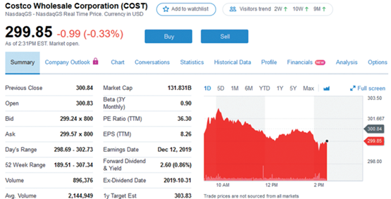
Stock Market Reporting: Costco
Price $503.69 is the real-time price of the last trade.
Reported change is from previous day’s closing price.
Opening price is first trade of day.
Bid and ask prices of $502.64 and $503.00, respectively.
Market “depth,” is number of shares sought at bid price and offered at ask price.
Volume is number of shares traded today.
Market Cap is number of shares outstanding multiplied by current price per share.
Yield is reported dividend divided by the previous stock price: $3.60 ÷ $503.69 = 0.71%.

